Slide 1
What Mole is that
By Bertram D’Hooge, the maker of Irisrecogniser 1000 and a generic houseprice predictor
The #1 Molespotter currently not on the market
According to us

Slide 2
Summary
What is what mole is that
How do you use what mole is that
How to improve what mole is that
What is next

Slide 3
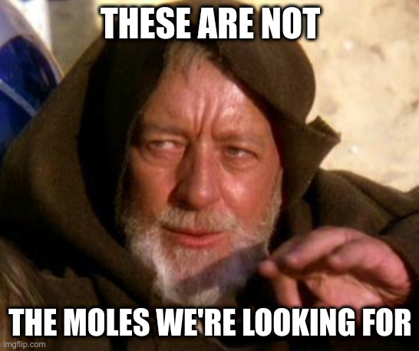
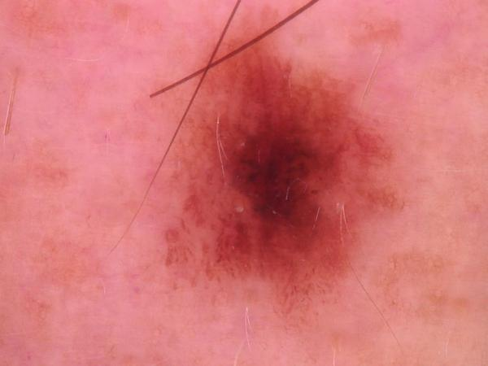
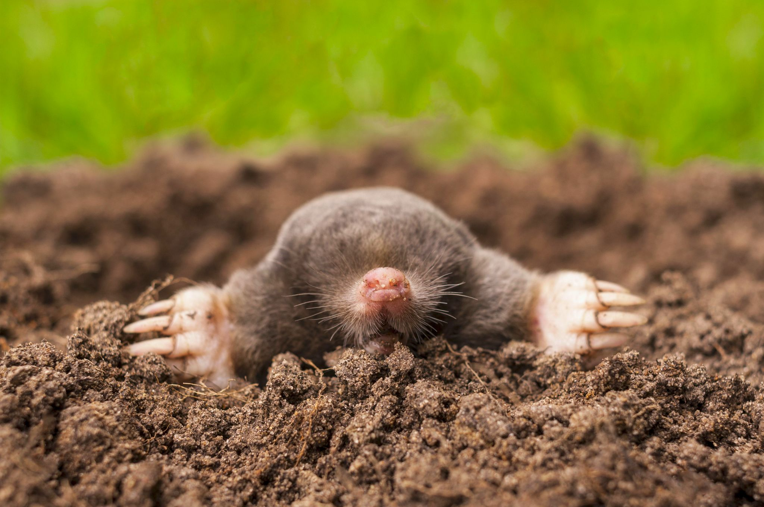
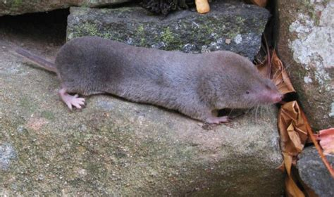
What is “What Mole is that”
A multilayer Convolutional Neural Network trained to recognise moles

Slide 4
What is “What Mole is that”
01
A bunch of labeled images.
02
Build a Neural Network. Feed it the processed images.
03
???
04
75% Accuracy

Slide 5
How do you use “What Mole is that”
Demo time!!!

Slide 6



How to improve “What Mole is that”
Deployment
Accuracy
Clean up the webapp

Slide 7
What next
What Mole is that
Cat or Dog
What is That
Mole Predictor
Animal recogniser
Anything recogniser

Slide 8




Thank you for your attention!
/BertramDHooge
/in/BertramDHooge

